Slide 1
Overview past two weeks
Joren Janzing

Slide 2
Content
Velocity in trough
PCA Analysis
If time: - Overview Plots

Slide 3
Velocity

Slide 4
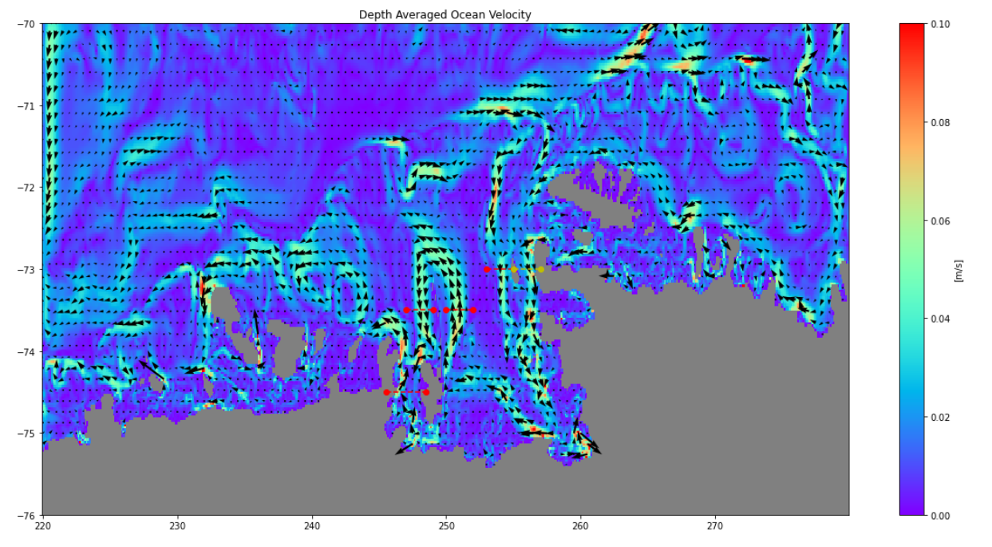
Method: Barotropic and Baroclinic Flow
PITE:
Pine Island Thwaites East
BRW: Bear Ridge West
Burke
BRE:
Bear Ridge
East
Dotson

Slide 5
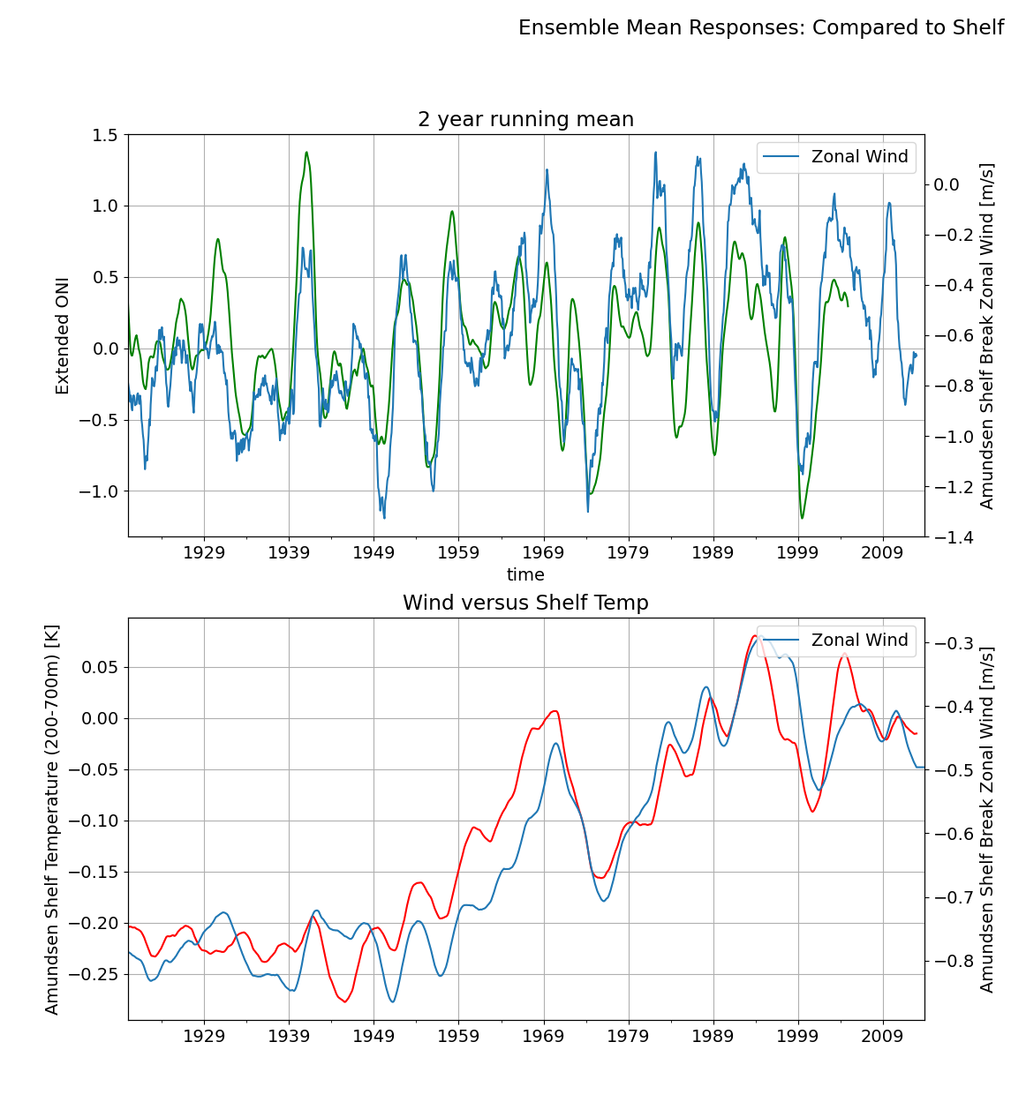
Context: Ensemble Mean Patterns
Two types of responses to wind:
‘Instantanious’ (e.g. wind to ONI)
‘Integrated’ (e.g. exponentially weighted wind and temperature)

Slide 6
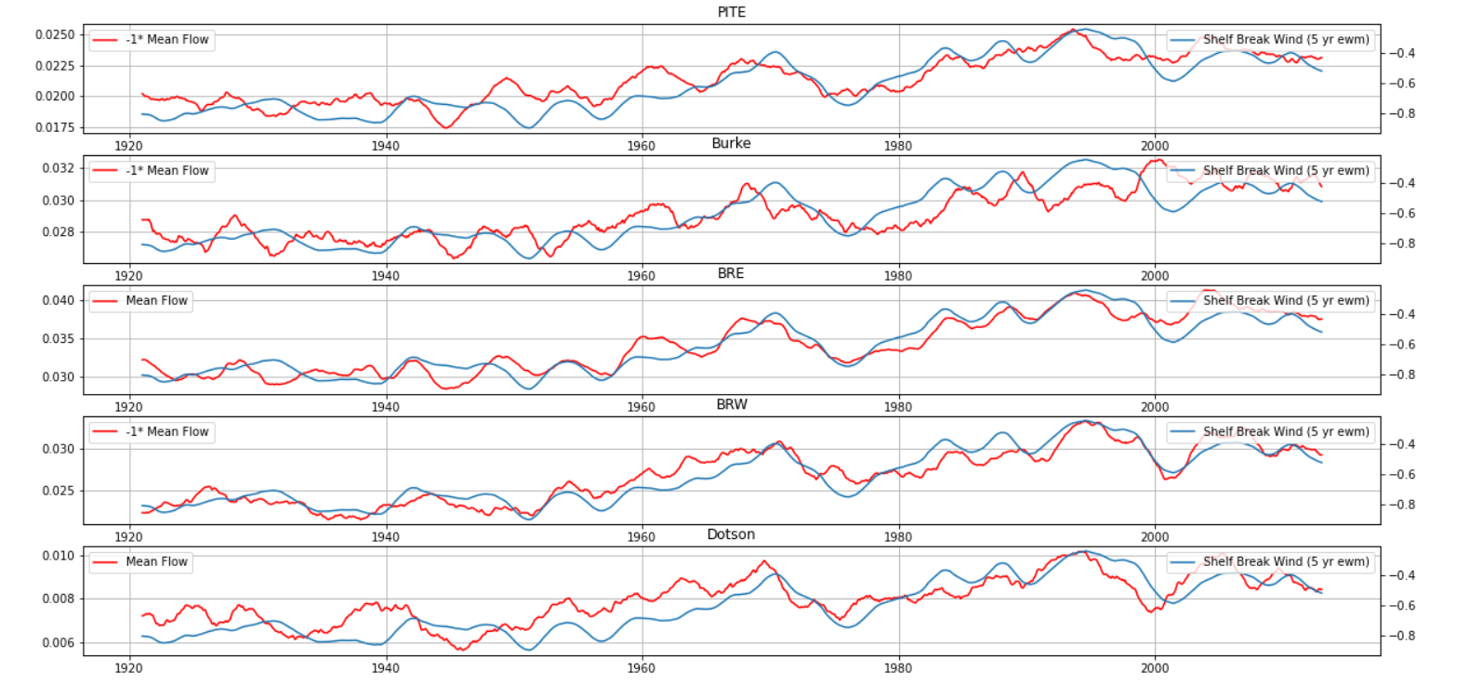
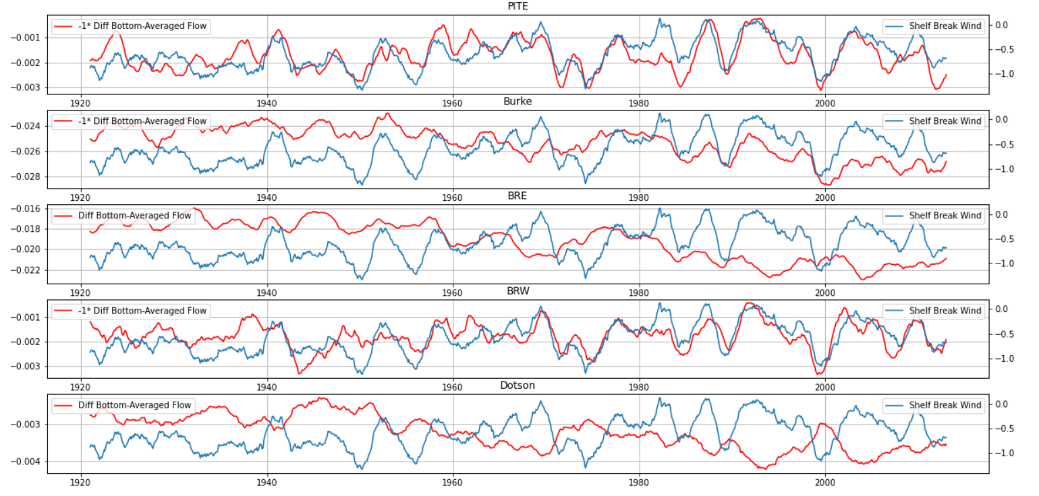
‘Barotropic’ Depth Averaged Flow vs Exponentially Weighted Wind
‘Baroclinic’ Bottom Flow Anomaly vs Wind: PITE Instantanious response

Slide 7
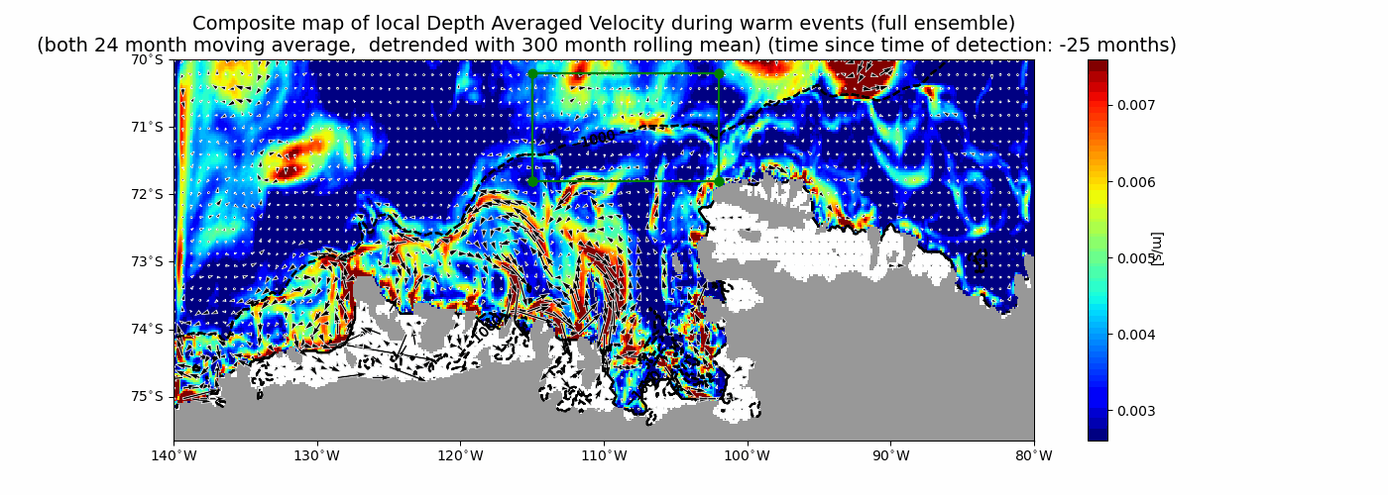
Warm Events: Barotropic Flow

Slide 8
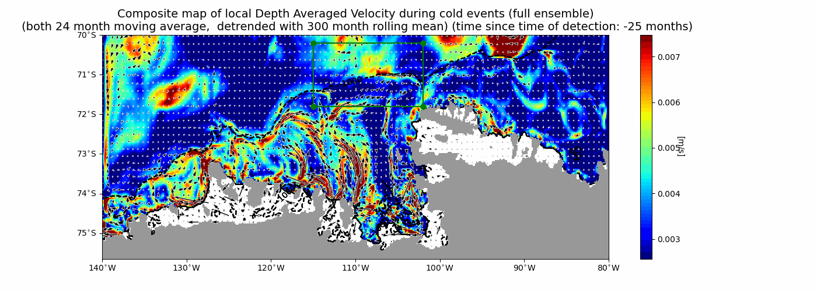
Warm Events: Baroclinic Flow

Slide 9
‘Barotropic’ Depth Averaged Flow vs Exponentially Weighted Wind
‘Baroclinic’ Bottom Flow Anomaly vs Wind: PITE Instantanious response

Slide 10
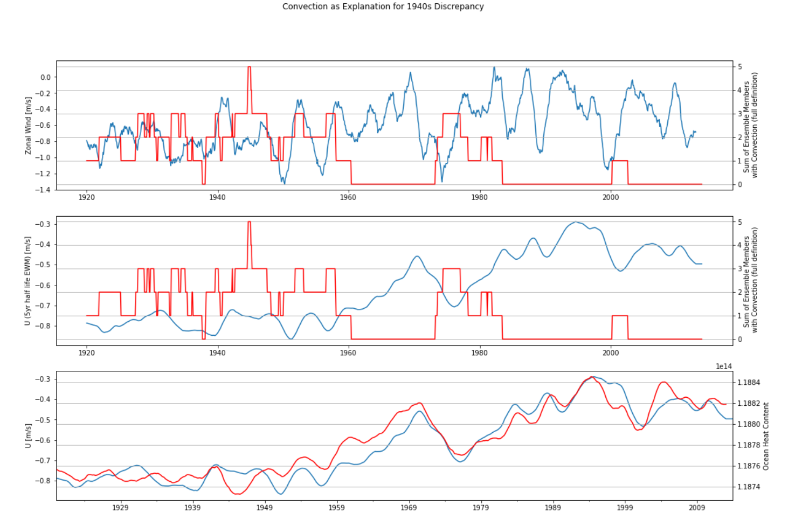
Red shows sum of members with convection (Narrow definition)

Slide 11
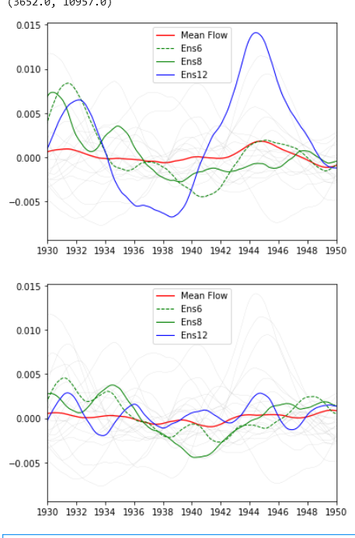
Depth Averaged Flow through PITE
Anomaly
Bottom 100m Flow through PITE
Anomaly

Slide 12
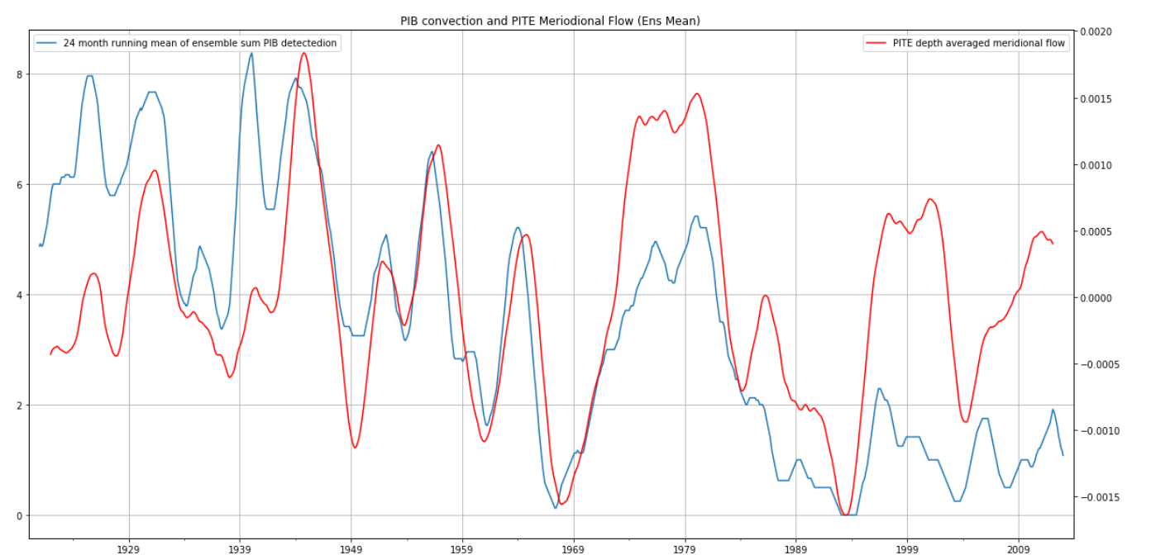
PITE Ensemble Mean Flow Determined by Strong Convection Outflow! (Wide definition)

Slide 13
Heat Advection

Slide 14
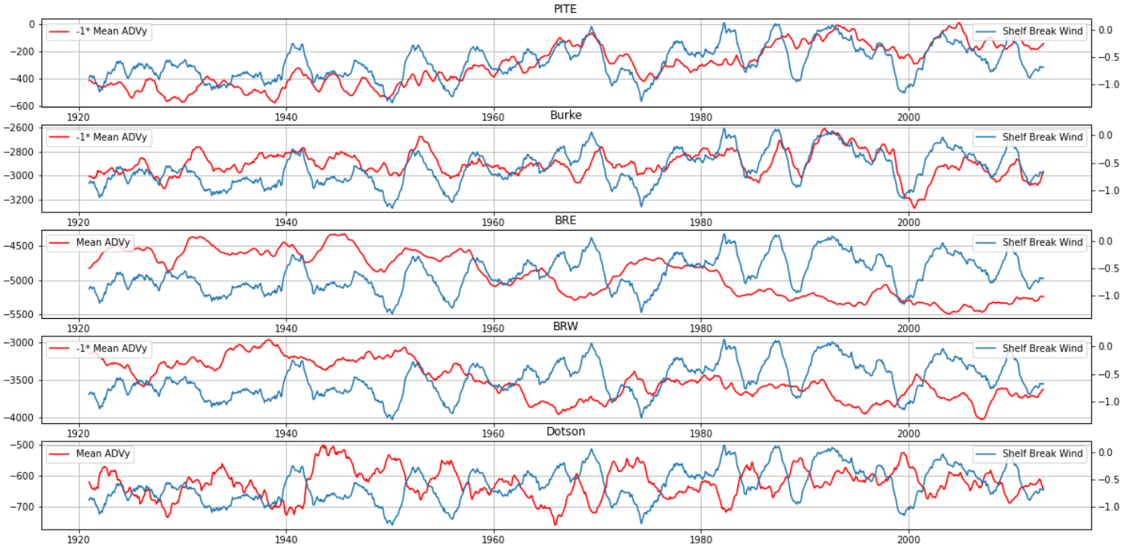
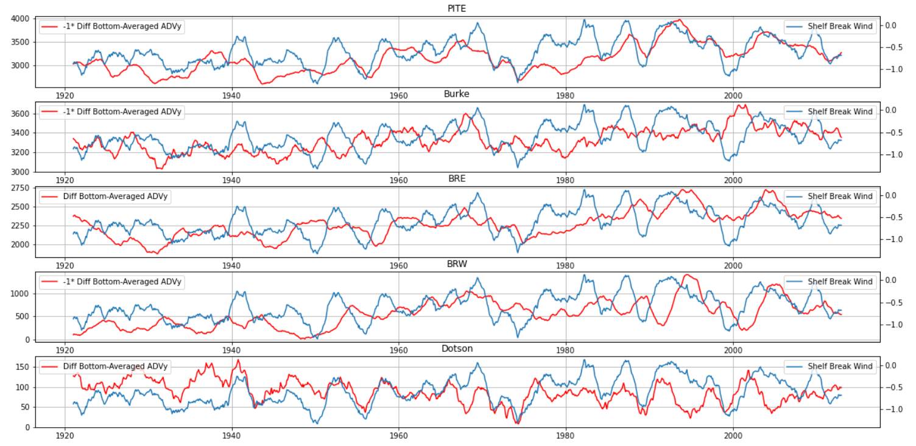
‘Barotropic’ Depth Averaged Advection vs Instantanious wind
‘Baroclinic’ Bottom Anomaly Advection vs Instantanious wind

Slide 15
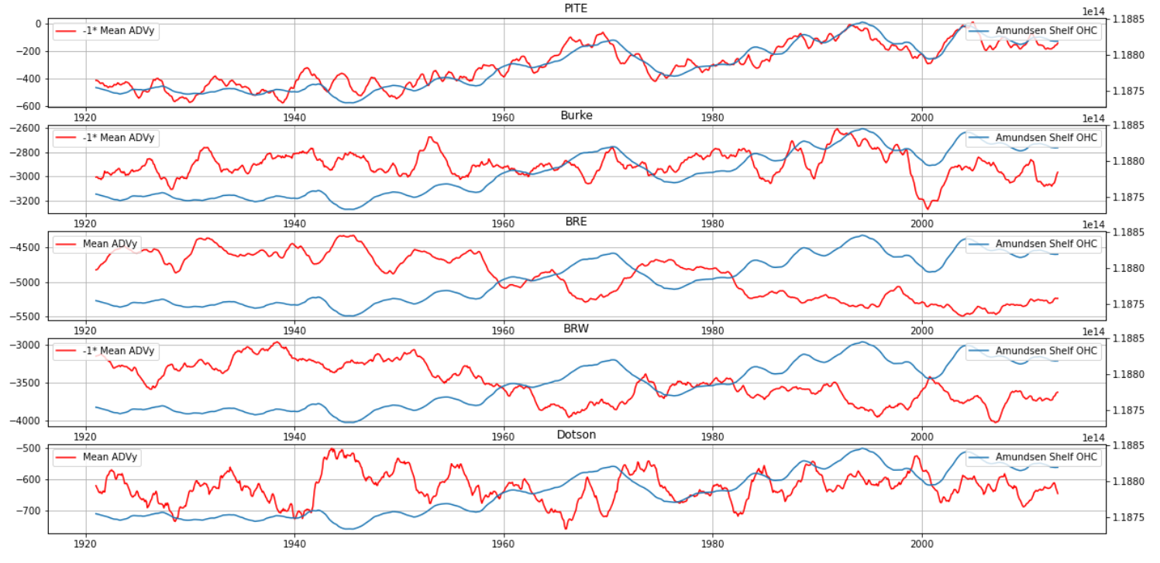
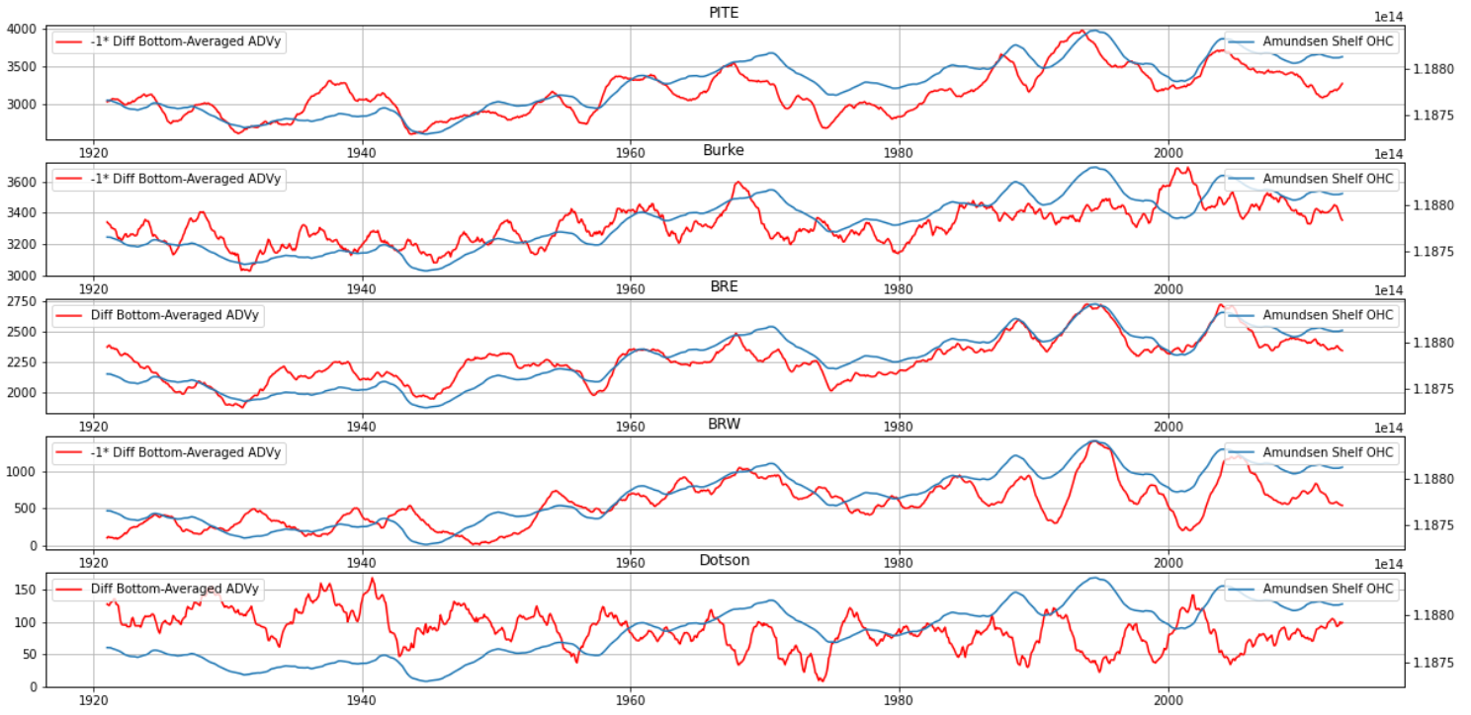
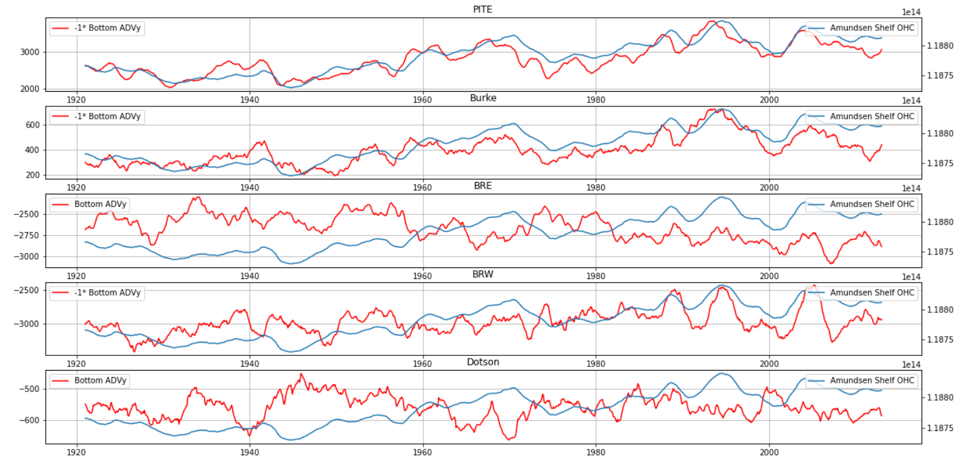
‘Barotropic’ Depth Averaged Advection vs Amundsen Shelf Heat Content
‘Baroclinic’ Bottom Anomaly Advection vs Amundsen Shelf Heat Content
‘Combined’ Absolute Bottom Advection vs Amundsen Shelf Heat Content

Slide 16
Subconclusion about Ensemble Mean
Long term ensemble mean flow seems roughly to respond to exponentially weighted mean of wind of 5 yr.
Baroclinic response directly governed by the wind, but interplay with long term influenced surroundings.
Heat advection is a bit confusion, but combination

Slide 17
Next Steps
Heat Advection Again: recompute it. Which process is most dominant? How to do this properly?
How does it work in individual members?
Composite
How is convection caused?

Slide 18
Principal Component Analysis
For Ensemble Mean,
Internal Variability (members – mean) and full ensemble

Slide 19
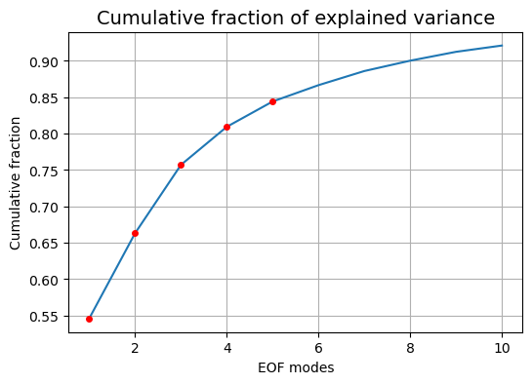
PCA of Ensemble Mean of Amundsen Shelf Temp
First 10 components explain roughly 90 percent of variance (!)

Slide 20
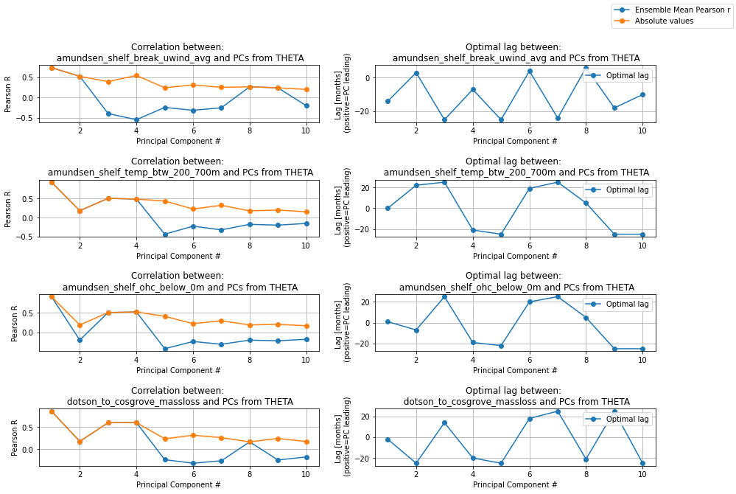

Slide 21
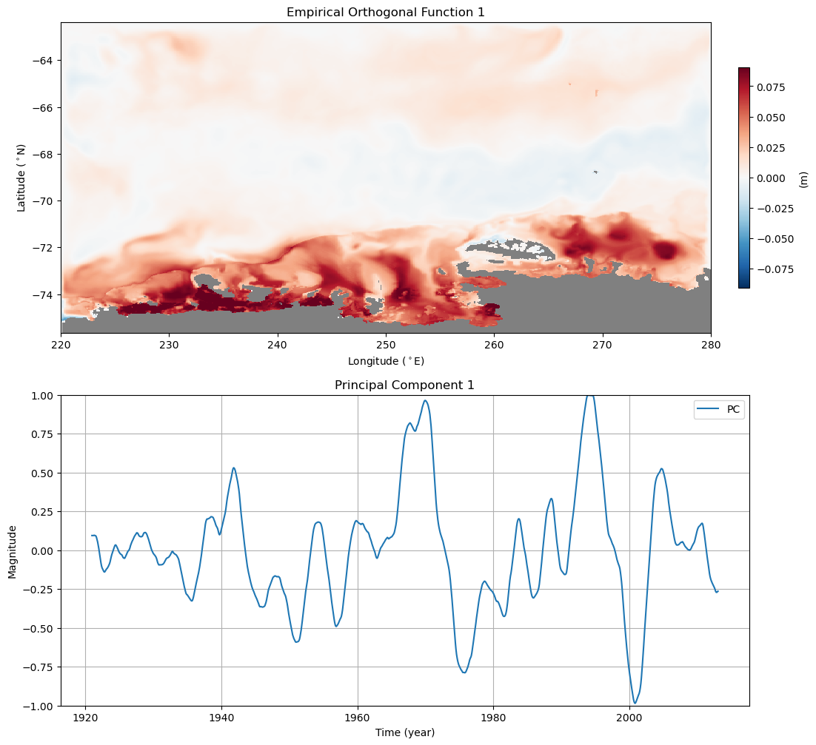
Timing: same time as event

Slide 22
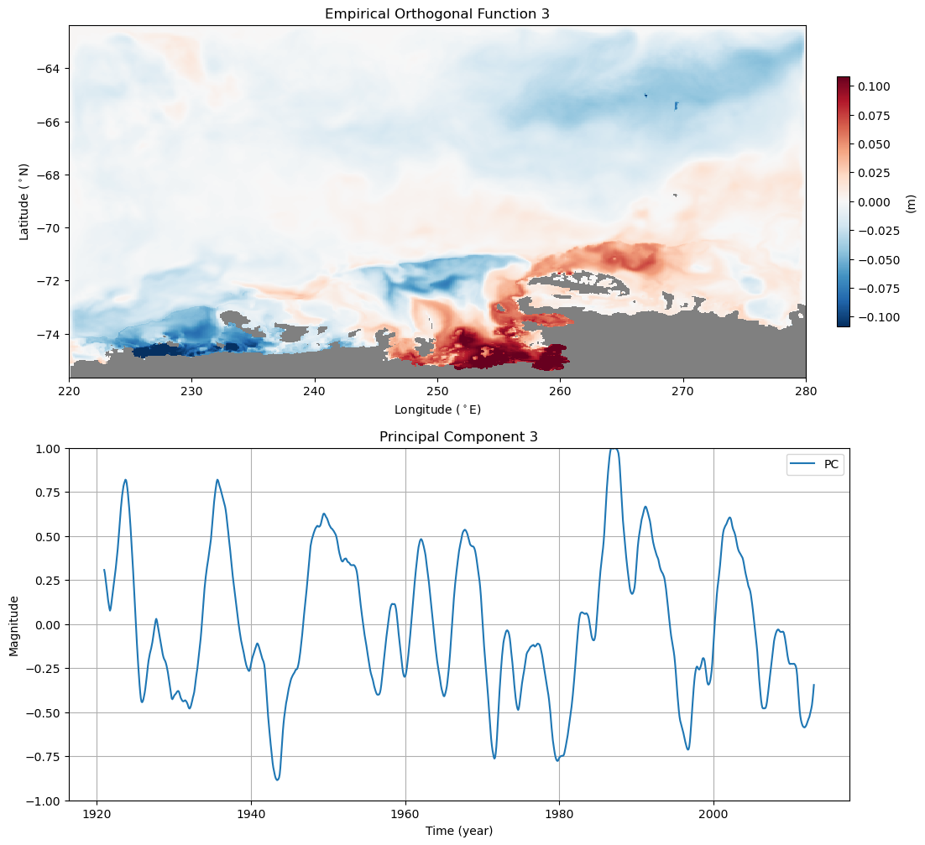
Timing: before event

Slide 23
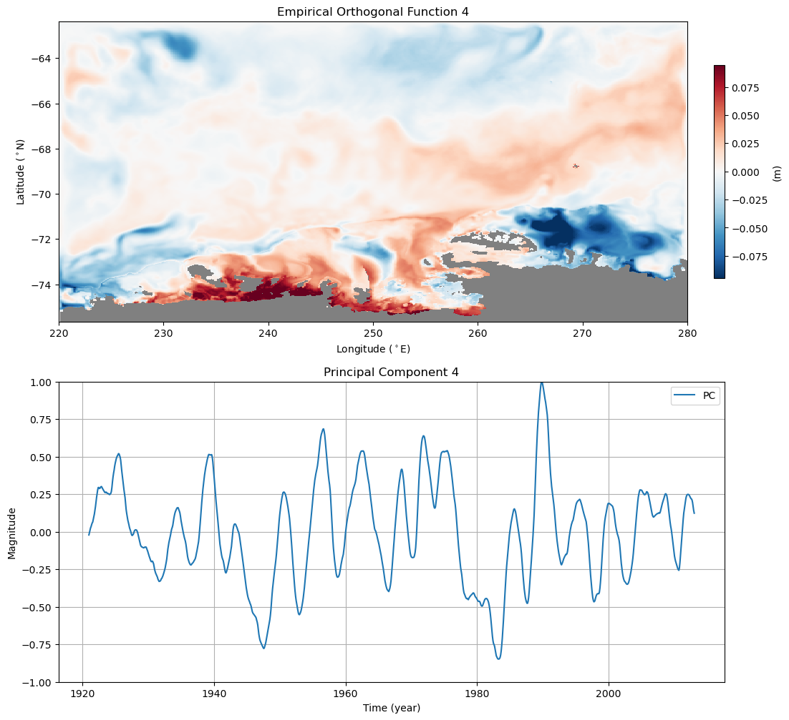
Timing: after event

Slide 24
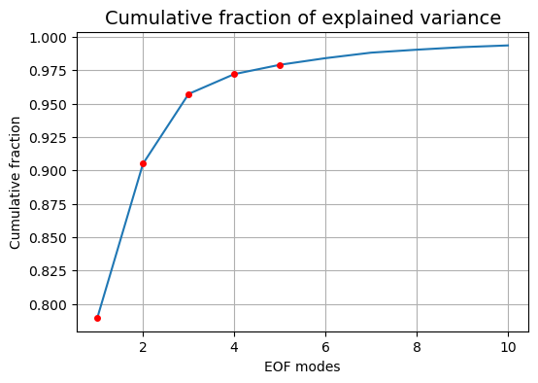
PCA of Ensemble Mean of Cumulative Zonal Wind

Slide 25
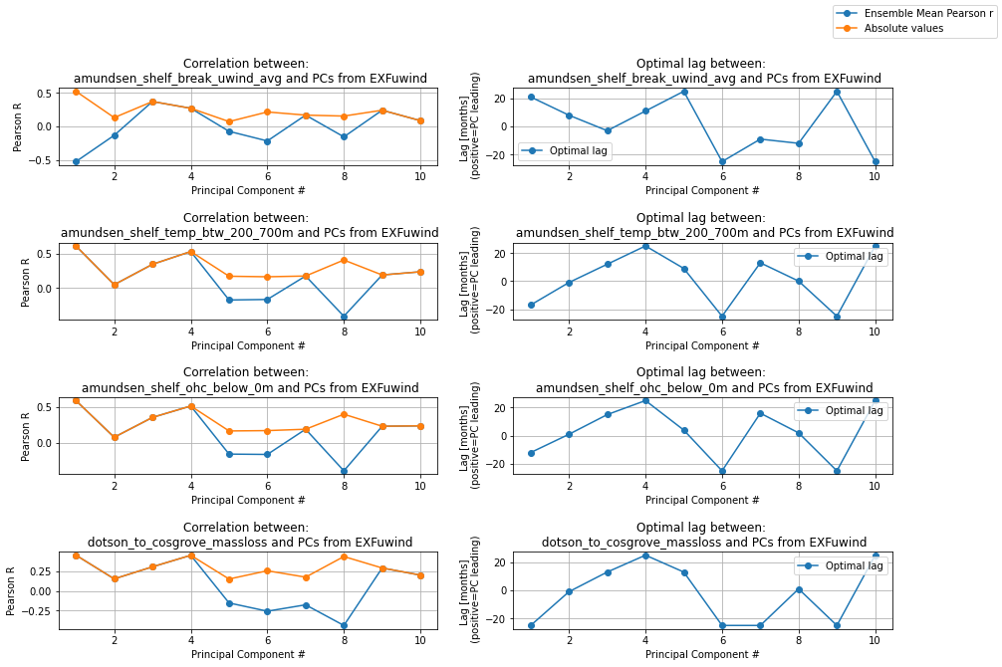
Cumulative Zonal Wind

Slide 26
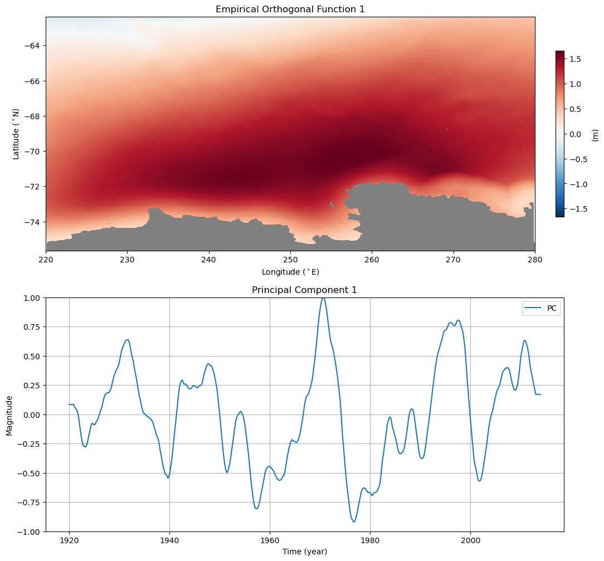
Timing:
Lagging behind event (?)!

Slide 27
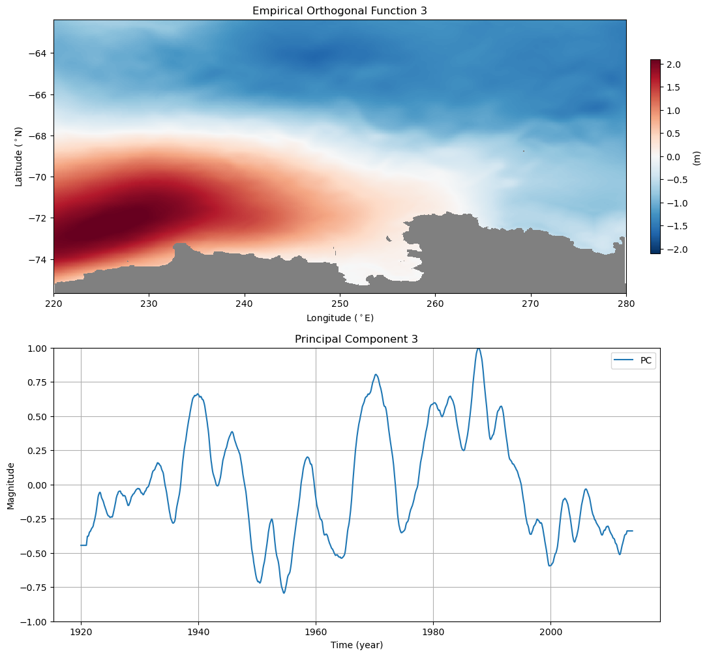
Timing:
Before event → Visible in Composites?

Slide 28
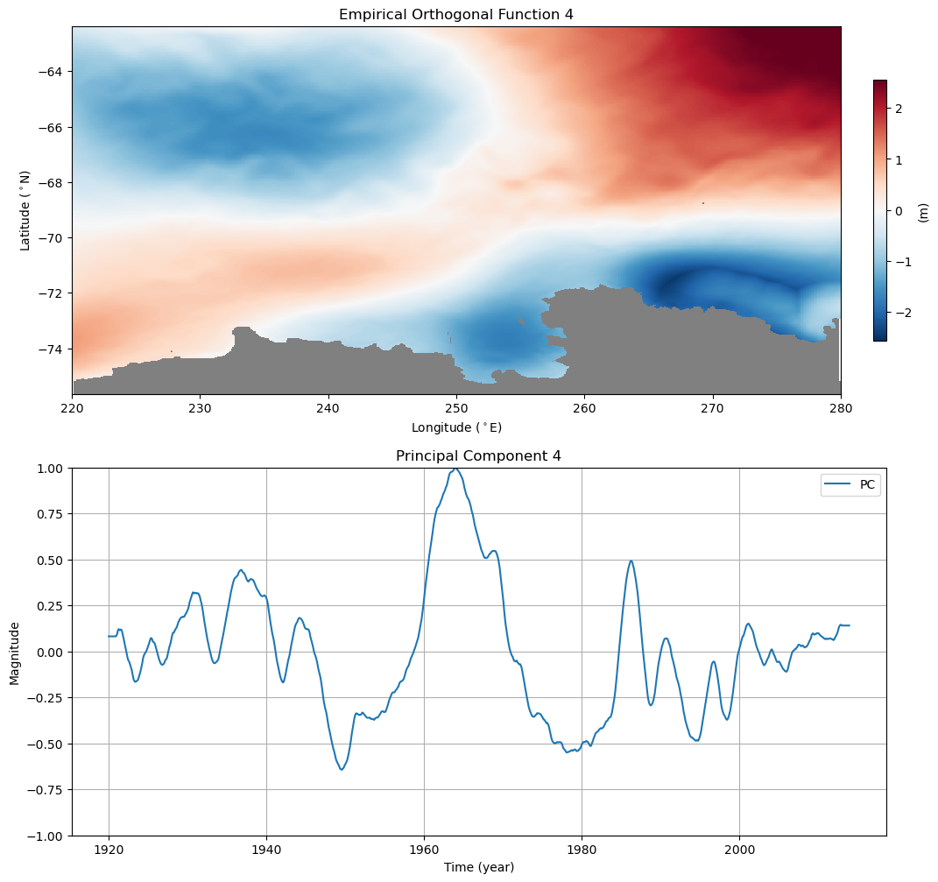
Timing:
before event!

Slide 29
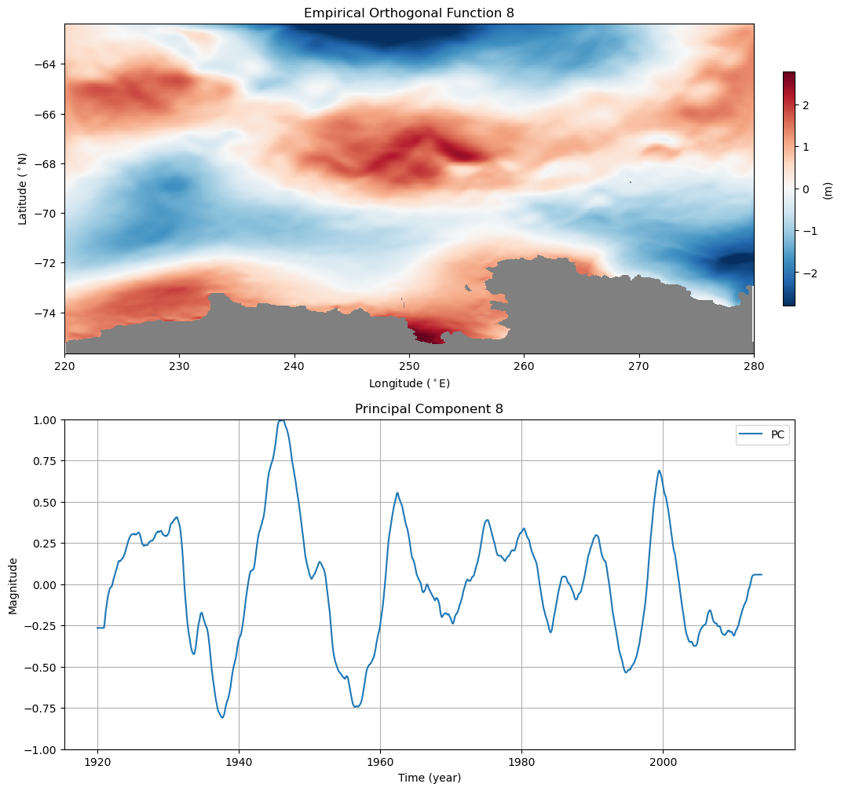
Timing:
Same time as event.
Related to convection?
Note: NEGATIVE CORRELATION

Slide 30
Overview Plots Member 6 in 1940s

Slide 31
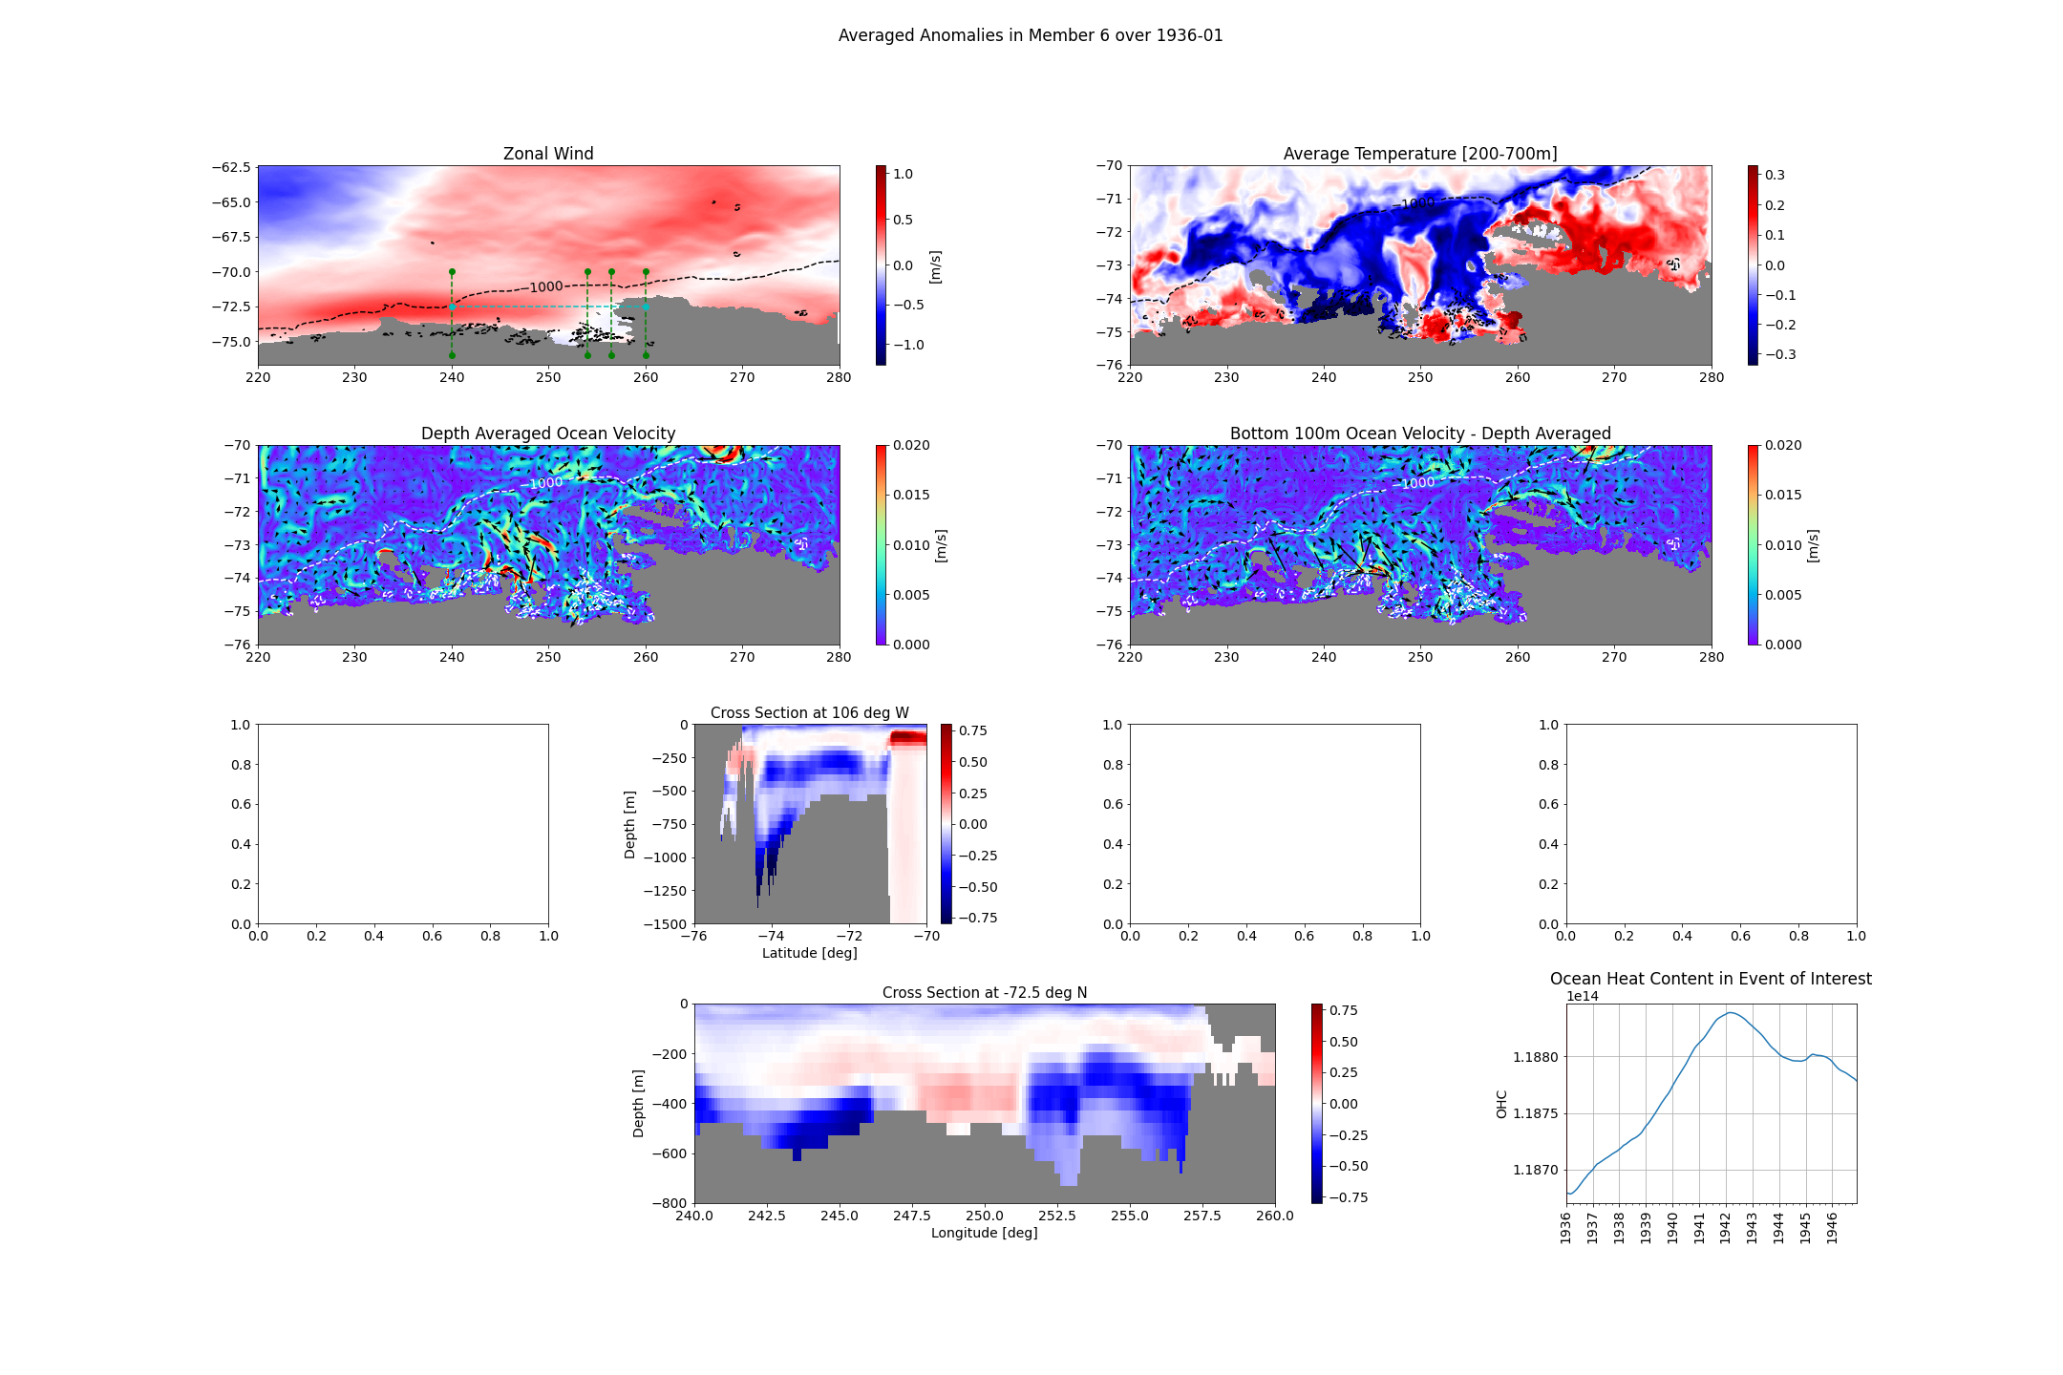

Slide 32
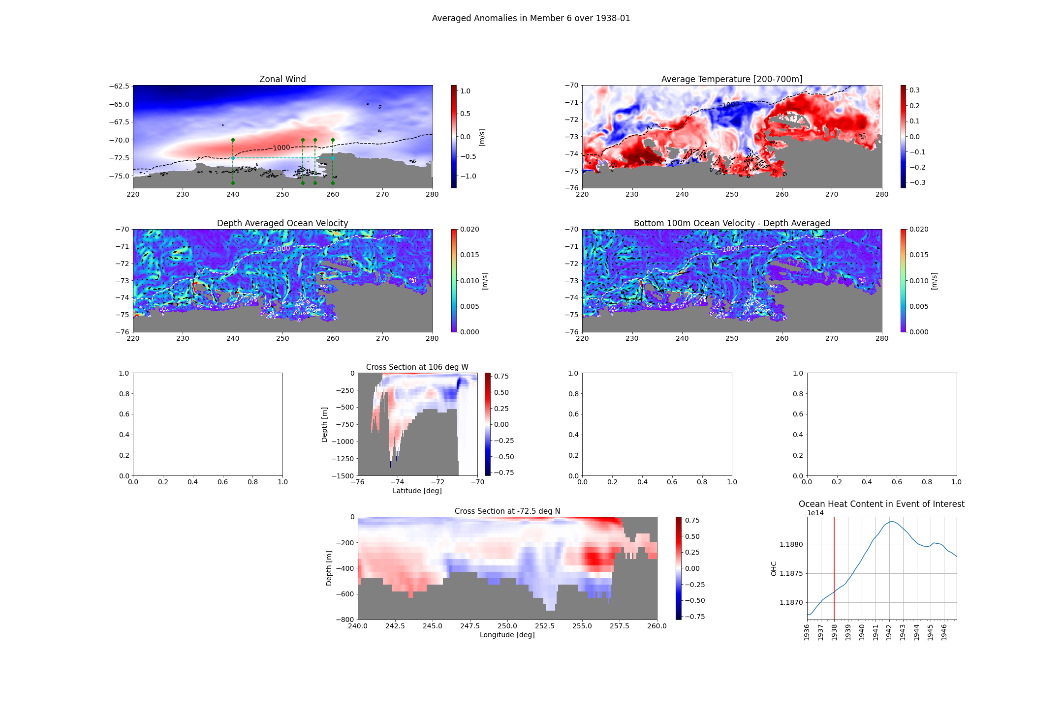

Slide 33
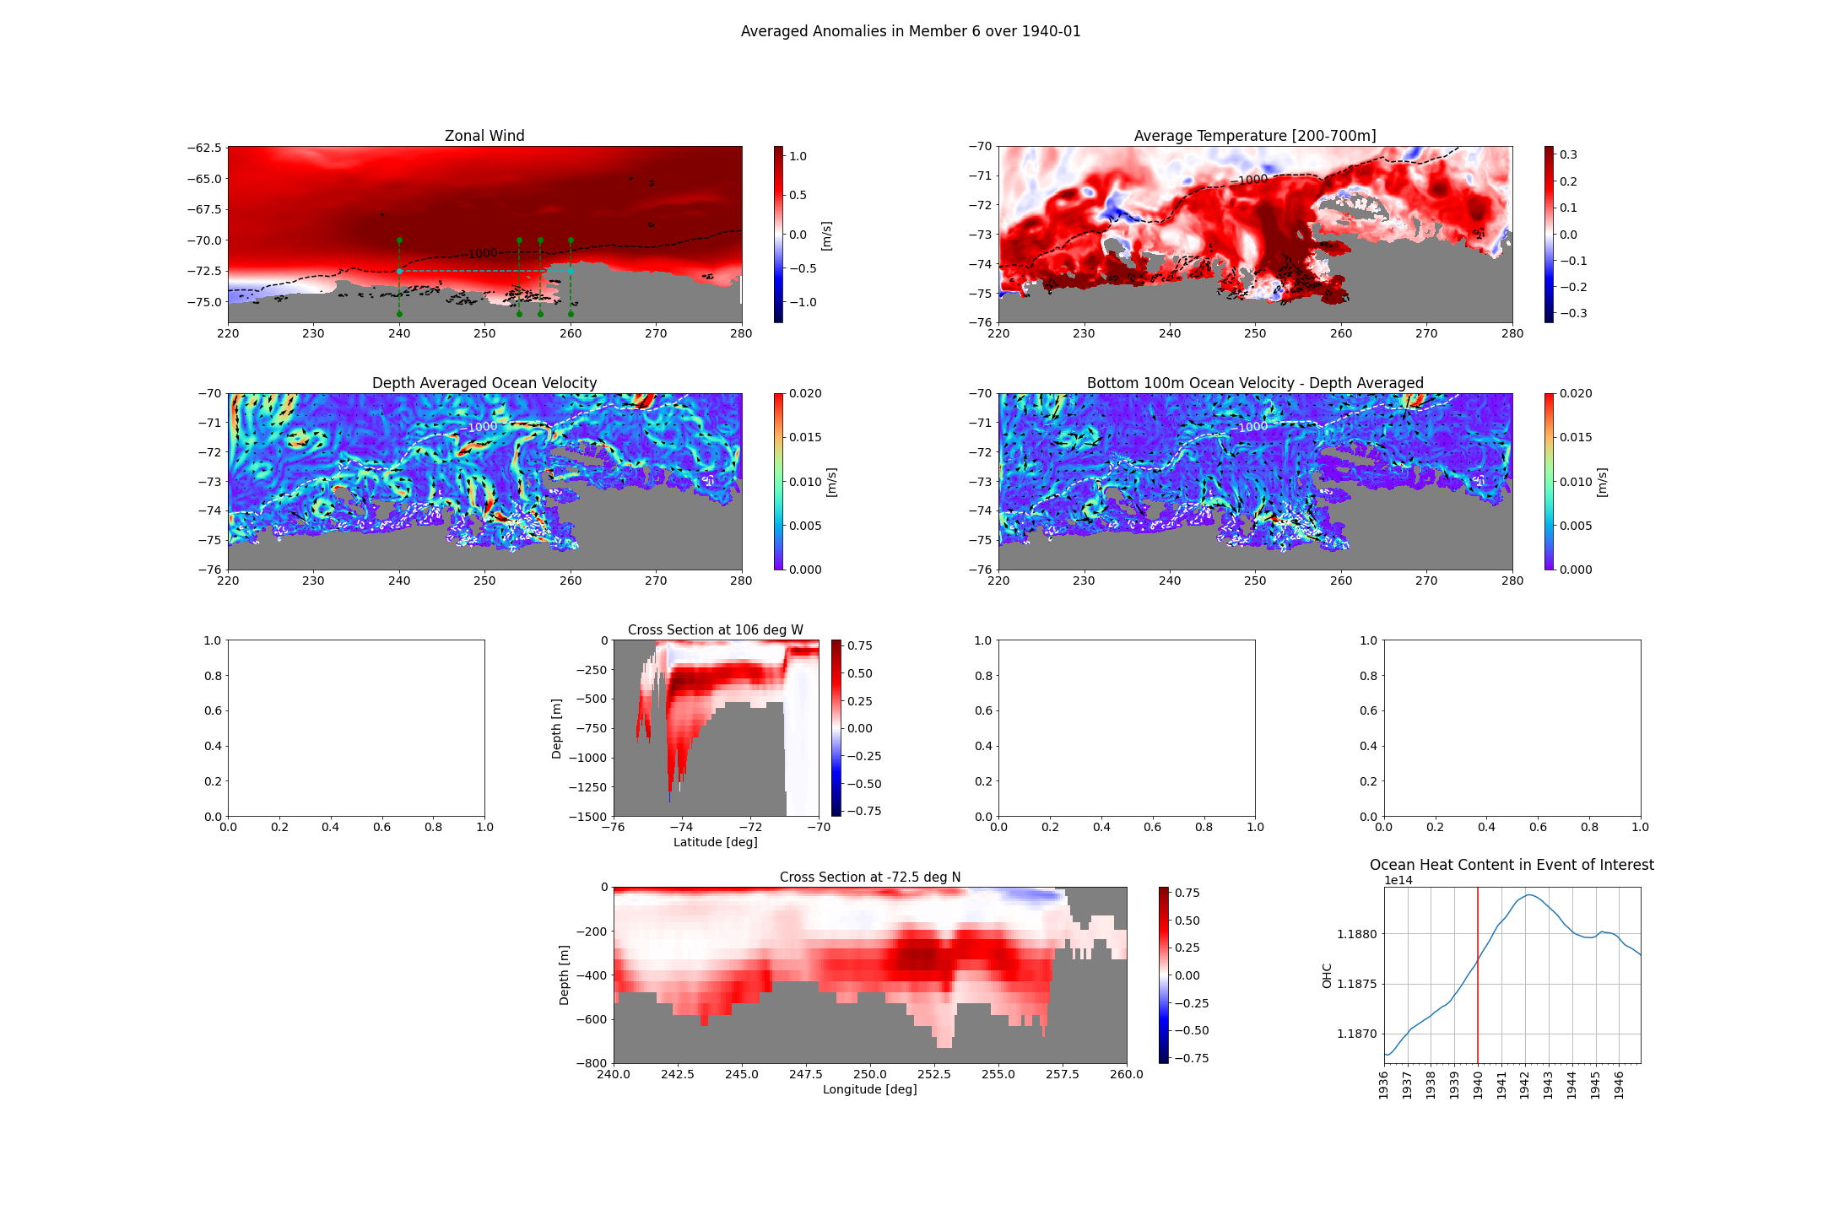

Slide 34
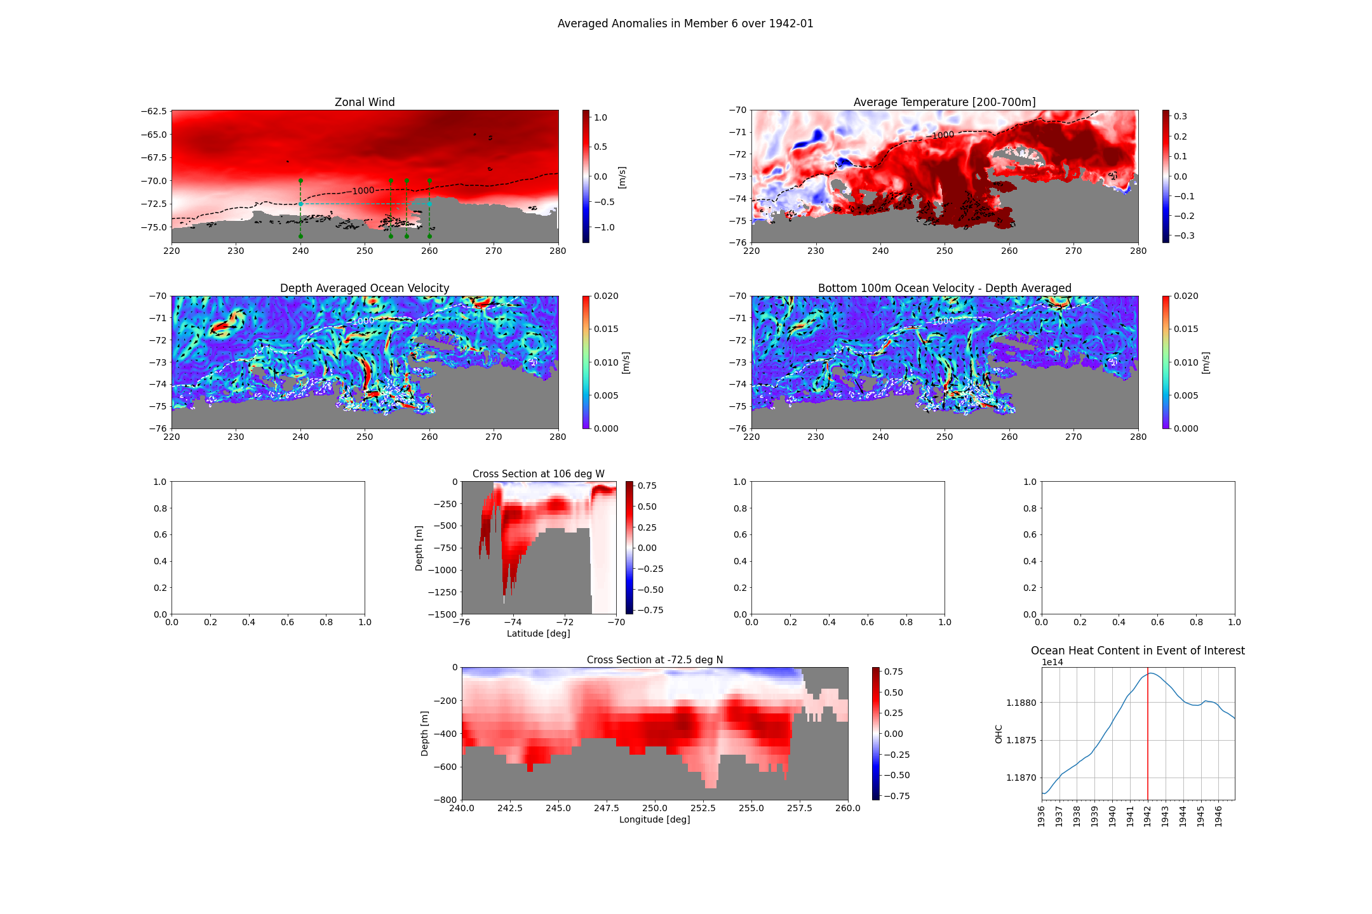

Slide 35
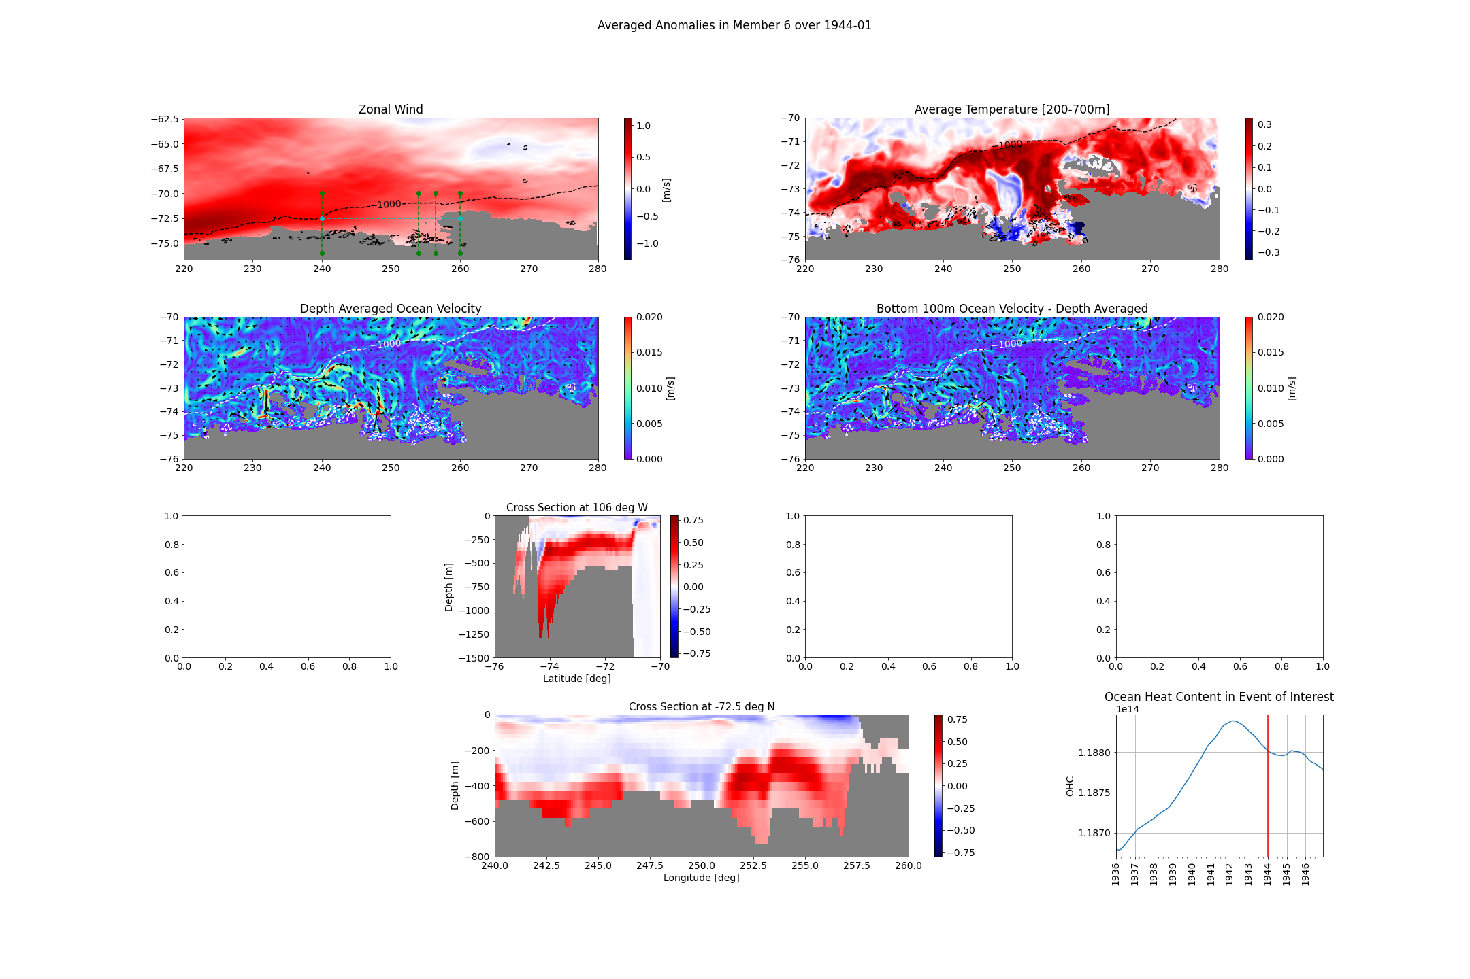

Slide 36
Questions
Is it useful?
General:
How to keep a good overview?
What is still needed?

Slide 37
Bonus: Overview Plots Member 10 in 1970s

Slide 38
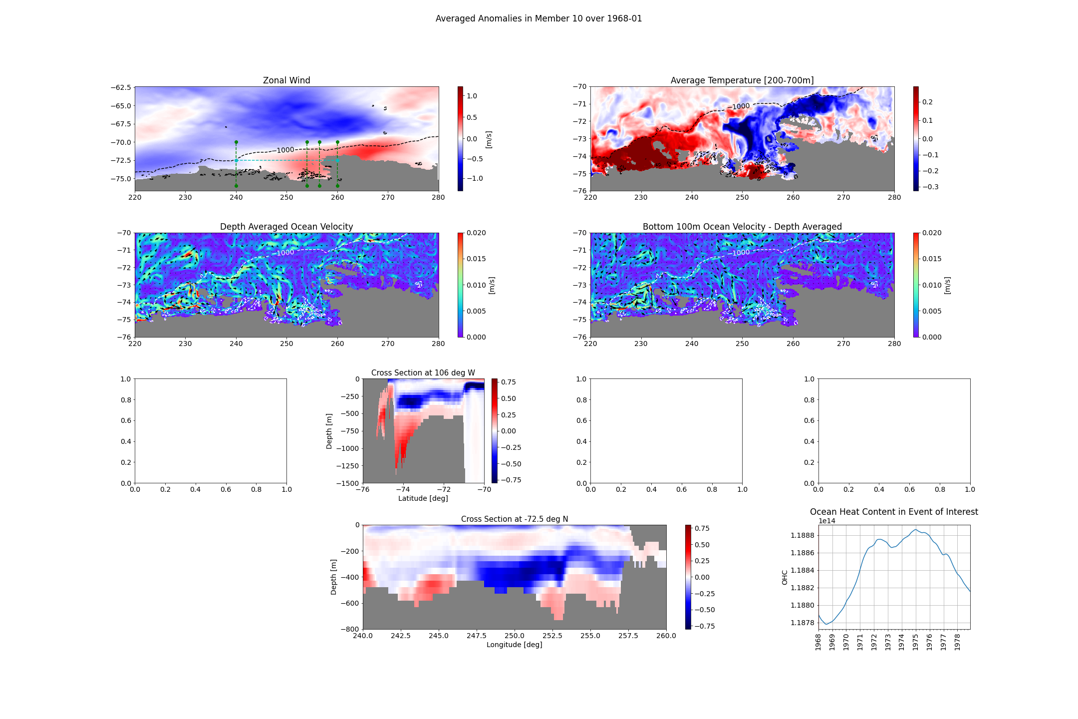

Slide 39
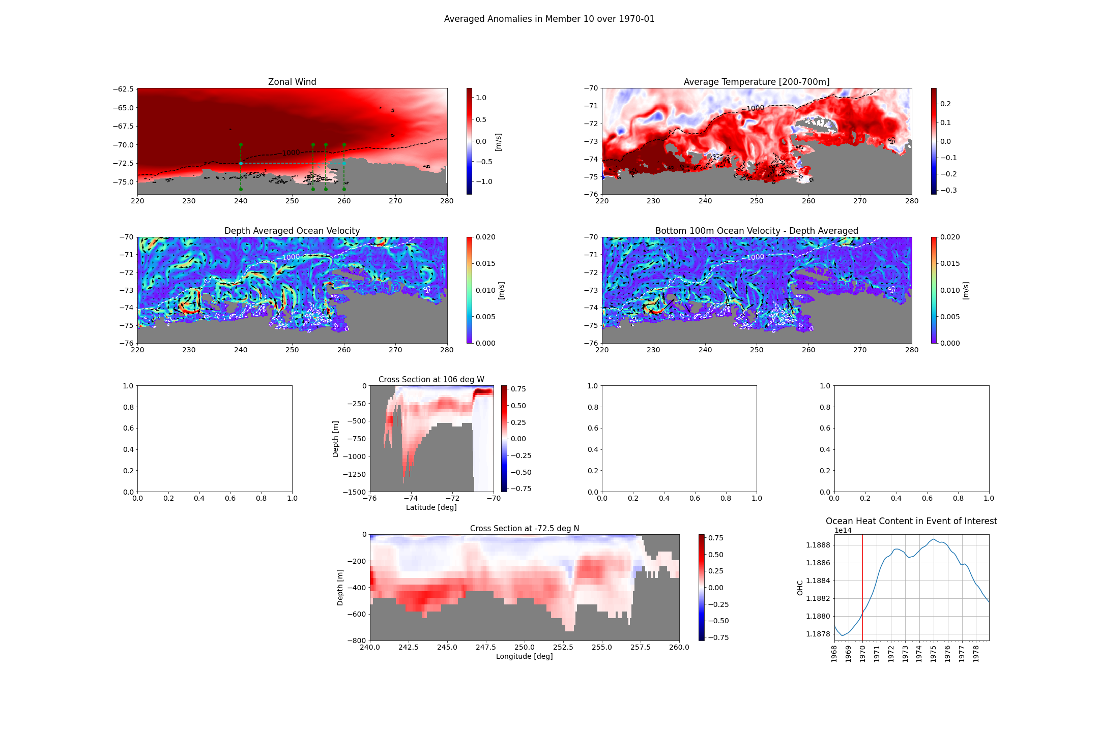

Slide 40
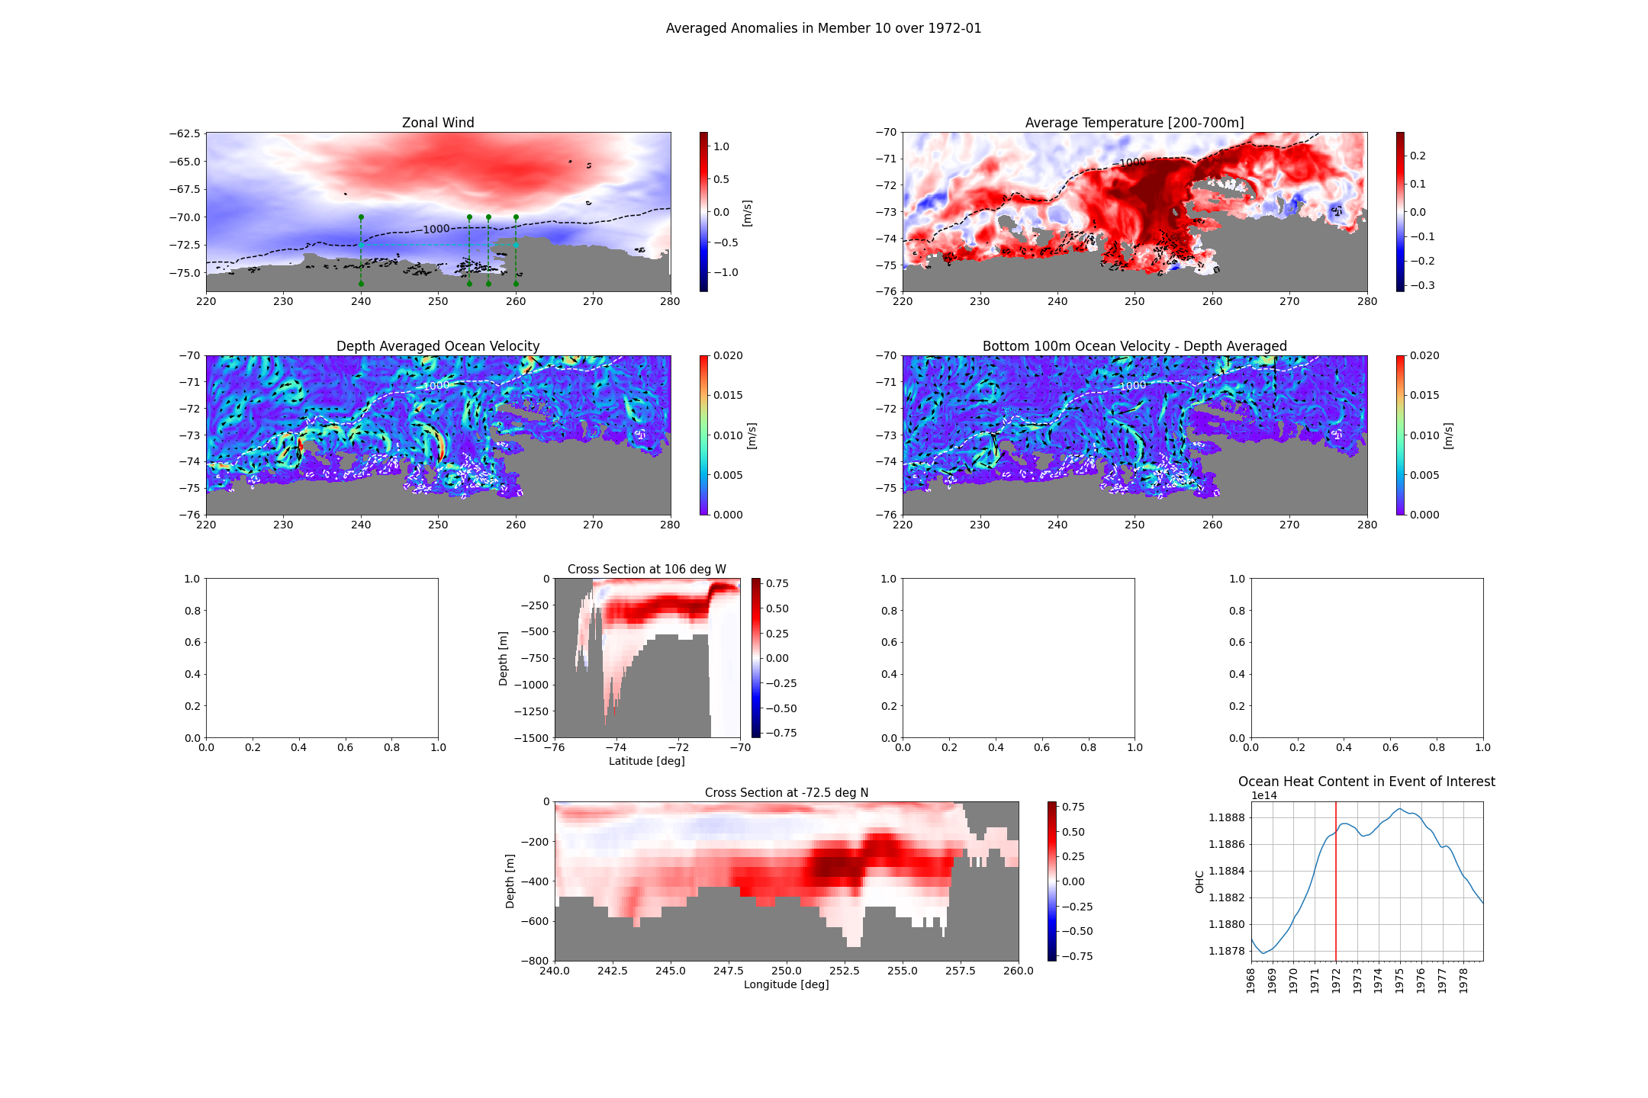

Slide 41
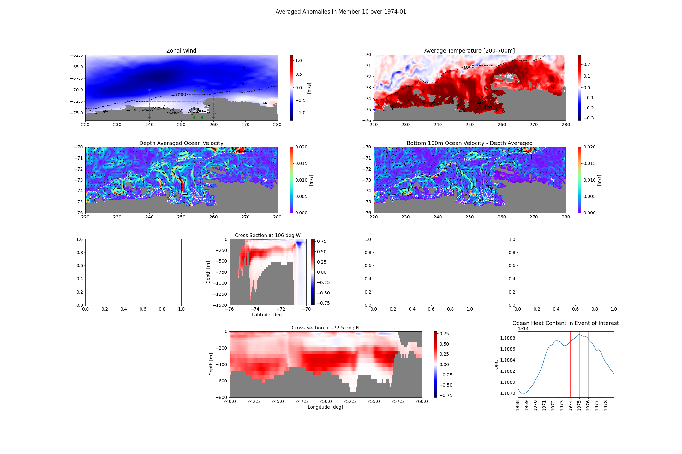

Slide 42
To Do:
Alessandro’s conclusie checken: coherence spectrum plots; zowel voor ensemble mean als voor members. (misschien ook voor verschillende periodes?)
Make a movie out of EOFs: - misschien ook maandelijks - misschien voor de shelf specifiek - misschien specifiek voor 1940s, 1970s en voor 1995s
Overview plots: - maandelijks - cross section door trough - misschien heat content ipv temperatuur? - ook voor composites?
Heat advection opnieuw (hoe gebruik je halve cellen? Of is dat al goed?)
Wat leidt tot convection? - Sea Ice en Wind
Back-up en code ordenen!

